Slide 1
pollination
the more the merrier?

Slide 2
Carol Clark

Slide 3
Merlin Tuttle

Slide 4
Alessio Sbarbaro

Slide 6
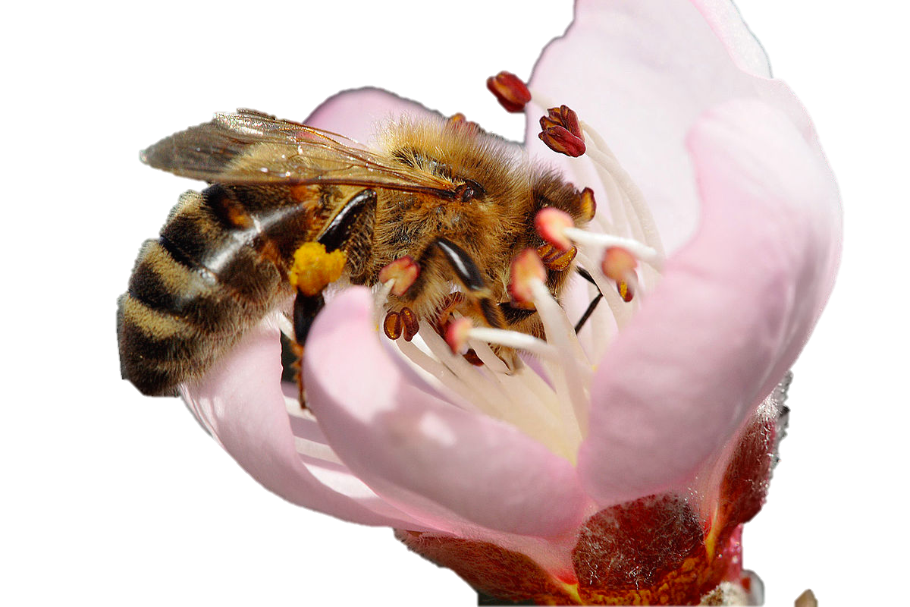
Fir0002

Slide 7
specialist pollinators can be more efficient than generalist pollinators
Larson 2005. Oecologia 146(3):394-403

Slide 8
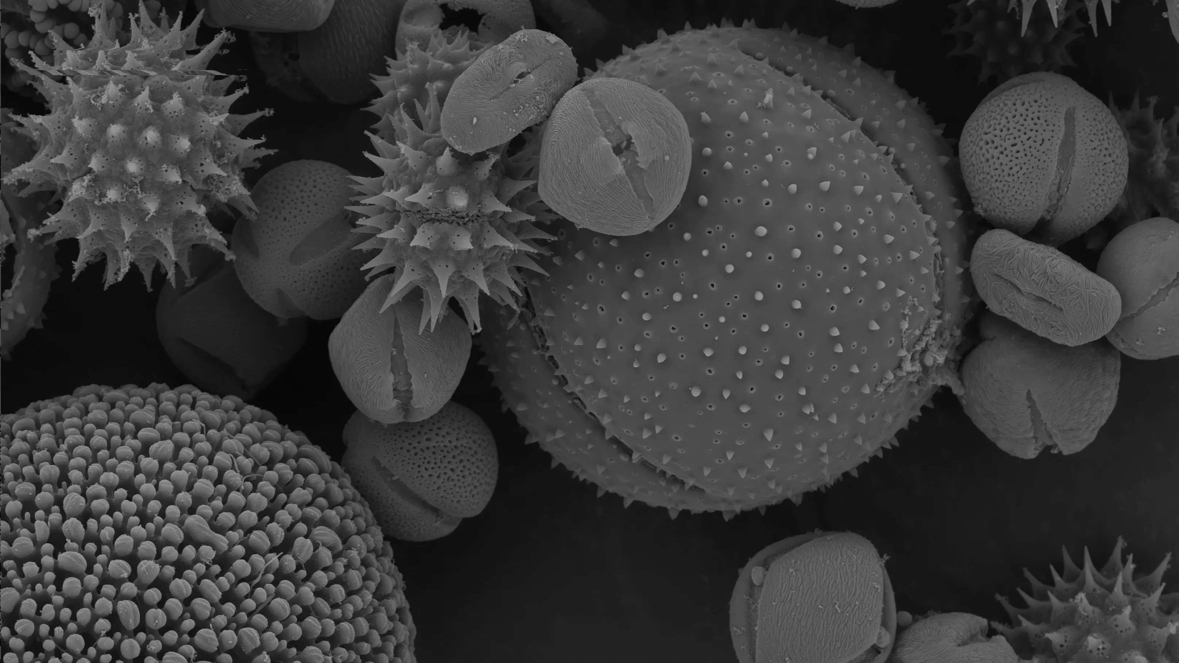
interspecific pollen transfer
Morales & Traveset 2008. Critical Reviews in Plant Sciences 4:221-238
Dartmouth Electron Microscope Facility

Slide 9
Interspecific pollen transfer can have
consequences
at the
individual &
species level
community level
Levin, D. A. & Anderson, W. W. Competition for Pollinators between Simultaneously Flowering Species. Am. Nat. 104, 455–467 (1970).
Galen, C. & Gregory, T. Consequences of foreign pollen contamination for seed set in the alpine wildflower, Polemonium viscosum. Oecologia 81, 120–123 (1989).
Feinsinger, P. & Tiebout III, H. M. Competition among plants sharing hummingbirds pollinators: Laboratoy experiments on a mechanism. Ecology 72, 1946–1952 (1991).
Caruso, C. M. & Alfaro, M. Effect of Castilleja linariaefolia pollen on seed set of Ipomopsis aggregata. Can. J. Bot. 78, 600–606 (2000).
Morales, C. L. & Traveset, A. Interspecific pollen transfer: Magnitude, prevalence and consequences for plant fitness. CRC. Crit. Rev. Plant Sci. 27, 221–238 (2008).
Brown, B. J., Mitchell, R. J. & Graham, S. A. Competition for pollination between an invasive species (Purple Loosestrife and a native congener. Ecology 83, 2328–2336 (2009).
Flanagan, R. J., et al. Interspecific pollinator movements reduce pollen deposition and seed production in mimulus ringens (Phrymaceae). Am. J. Bot. 96, 809–815 (2009).
Mitchell, R. J., Flanagan, R. J., Brown, B. J., Waser, N. M. & Karron, J. D. New frontiers in competition for pollination. Ann. Bot. 103, 1403–1413 (2009).
Waser, N. M. Competition for Hummingbird Pollination and Sequential Flowering in Two Colorado Wildflowers. Ecology 59, 934–944 (2016).
and many more…
Harder, L. D. & Wilson, W. G. Theoretical consequences of heterogeneous transport conditions for pollen dispersal by animals. Ecology 79, 2789–2807 (1998).
Muchhala, N., Brown, Z., Armbruster, W. S. & Potts, M. D. Competition Drives Specialization in Pollination Systems through Costs to Male Fitness. Am. Nat. 176, 732–743 (2010).
Arceo-Gómez, G. & Ashman, T. L. Heterospecific pollen deposition: Does diversity alter the consequences? New Phytol. 192, 738–746 (2011).

Slide 10
there should be a trade-off between the number of pollinators and the quality of pollination
hypothesis:
Dartmouth Electron Microscope Facility

Slide 11
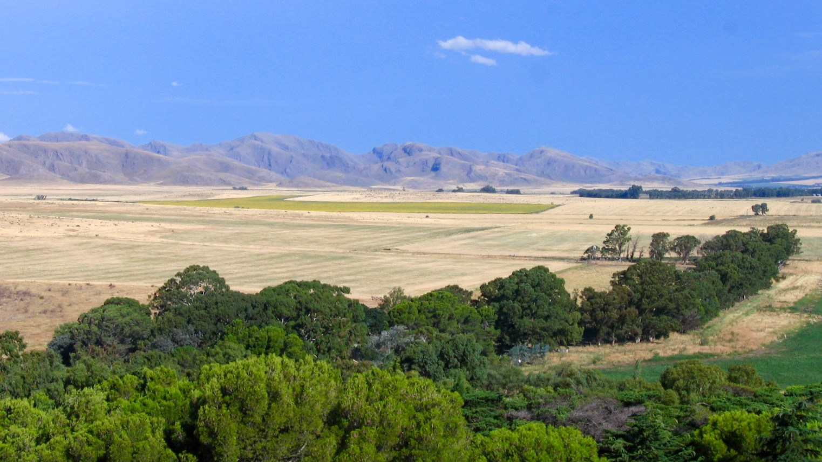
Jiròni B.

Slide 12
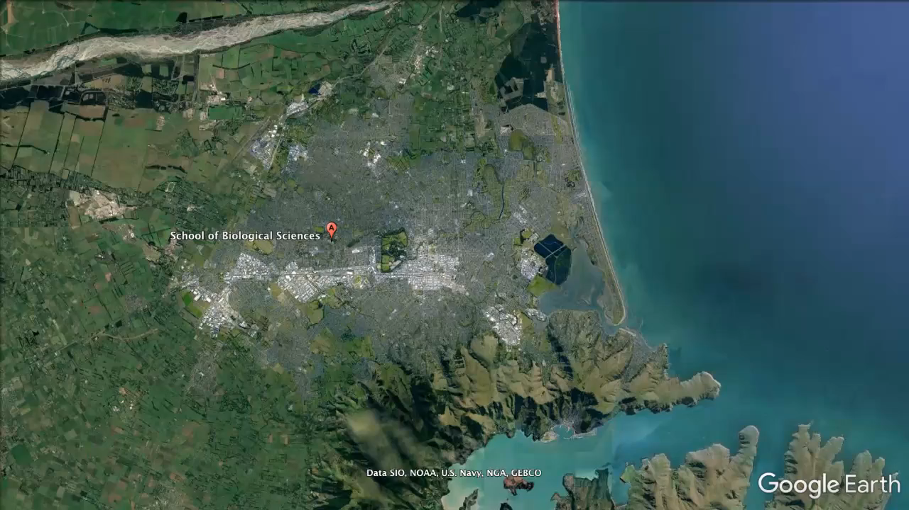

Slide 13
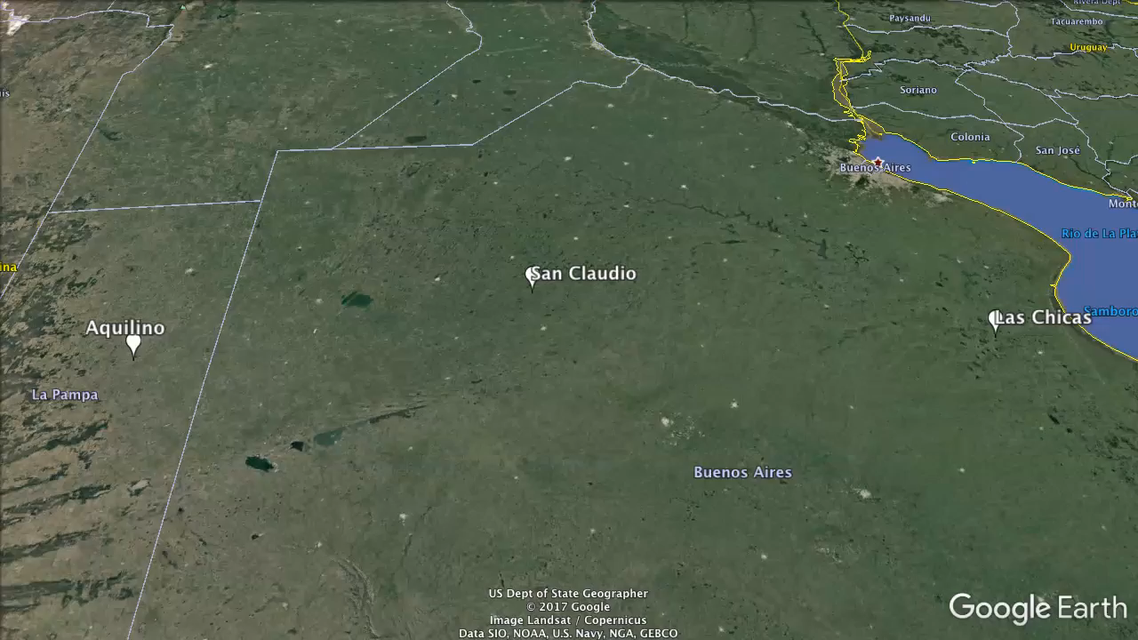

Slide 14
3 sites x 2 land uses x 2 transects
- pollen on stigmas
Martin Oeggerli – National Geographic

Slide 15
3 sites x 2 land uses x 2 transects
- pollen on stigmas
- pollen on animals

Slide 16
3 sites x 2 land uses x 2 transects
- pollen on stigmas
- pollen on animals
- visitation
- abundance

Slide 17
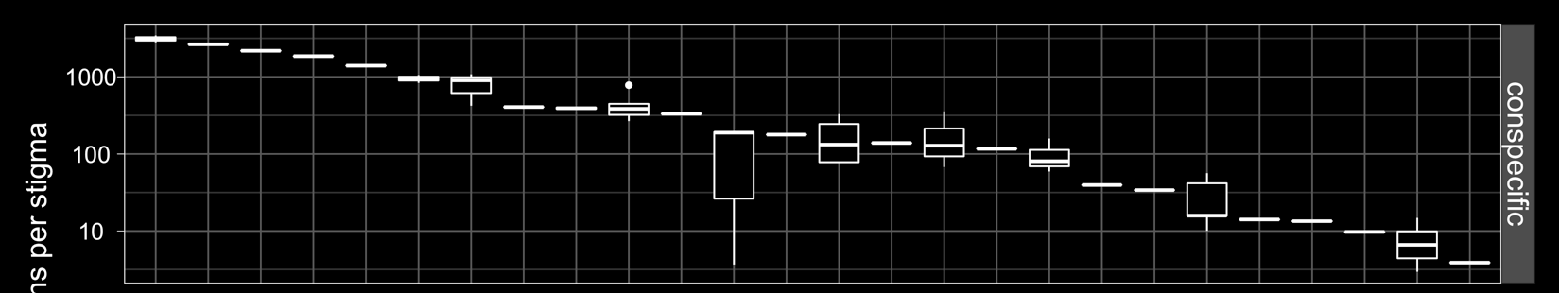
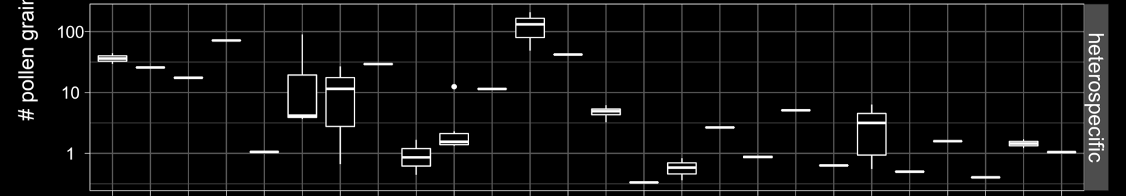
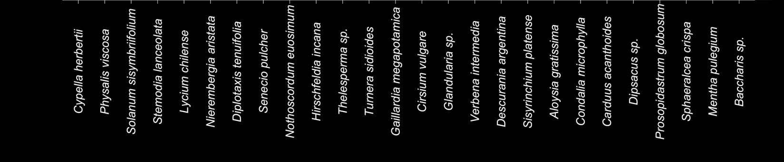

Slide 18
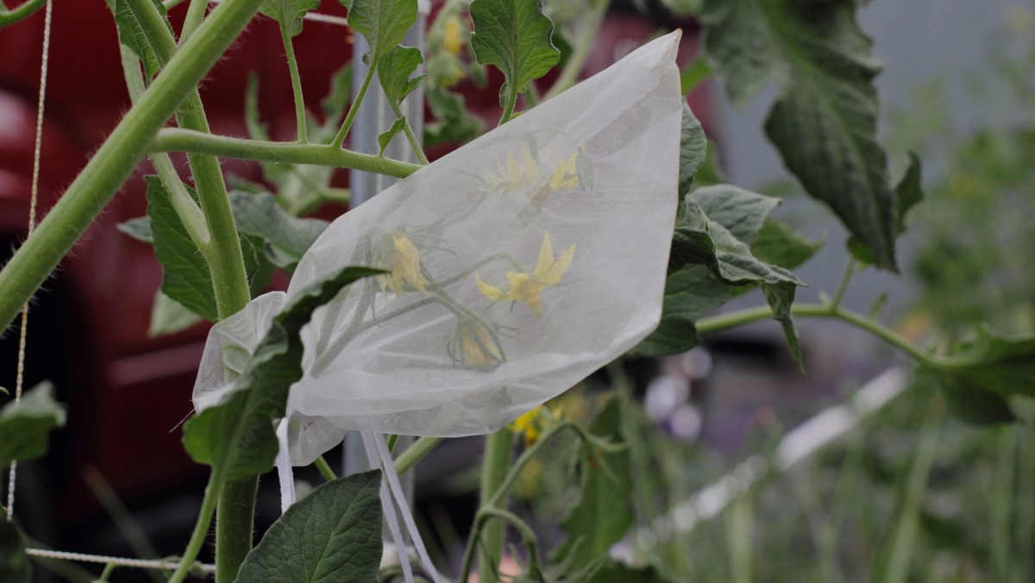
we need to account for self-pollination
Karron et al. 2009. Annals of Botany. 103(9):1379–1383
Helena Jole

Slide 19
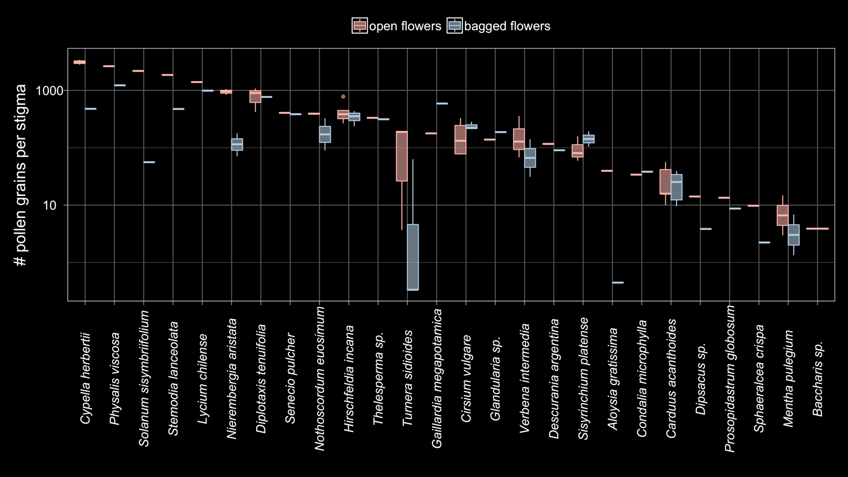

Slide 20
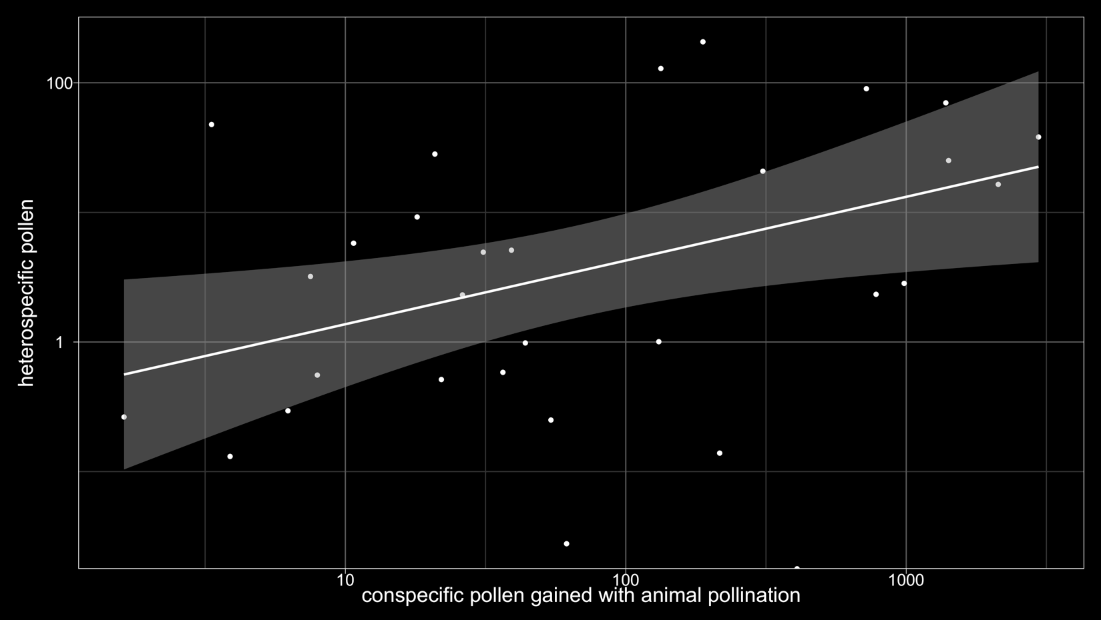

Slide 21
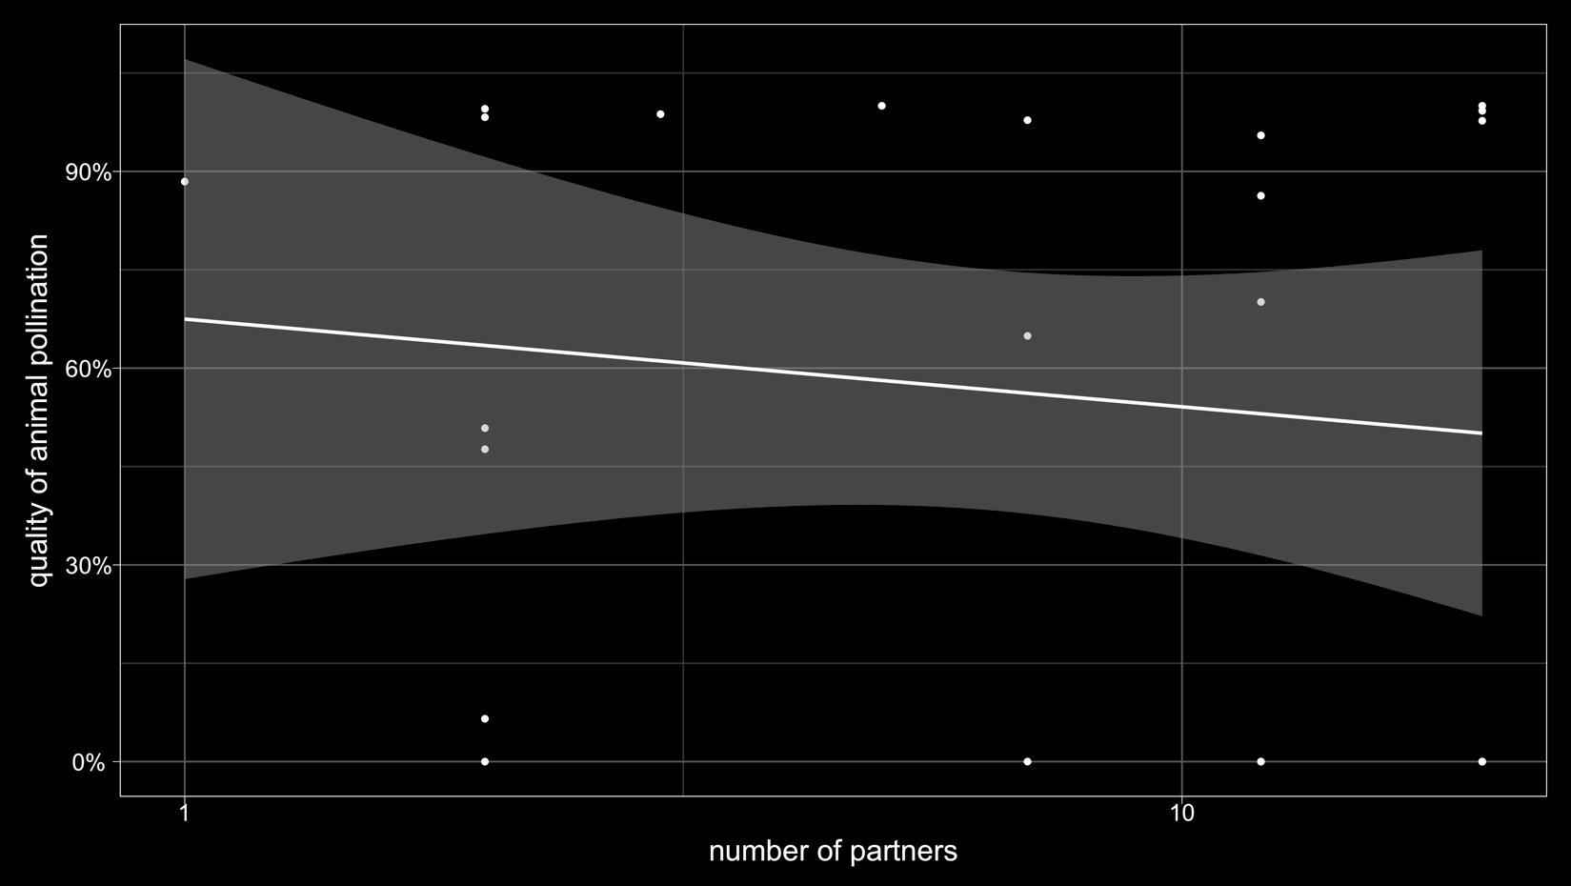

Slide 22
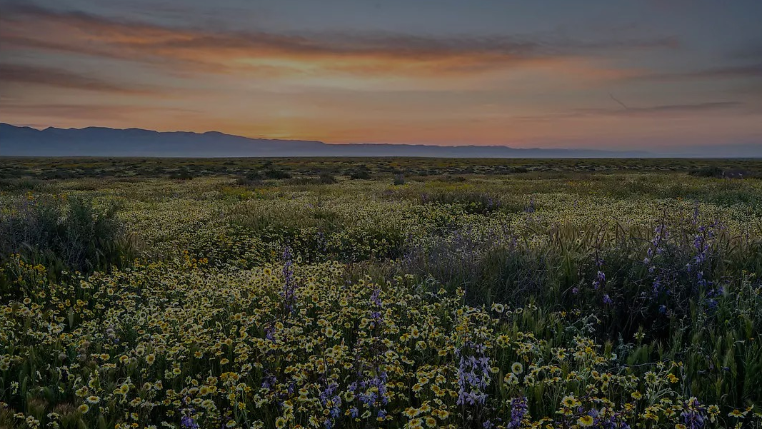
no trade-off
perhaps plants are using mechanisms to overcome it

Slide 23
pollination, the more the merrier?
Fernando Cagua¹, Hugo Marrero², Jason Tylianakis¹, Daniel Stouffer¹
¹ Centre for Integrative Ecology, School of Biological Sciences, University of Canterbury, New Zealand
² National Scientific and Technical Research Council, Argentina
fernando@cagua.co

Slide 24
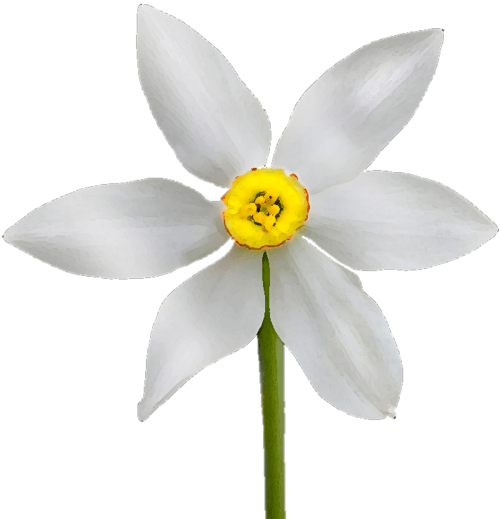
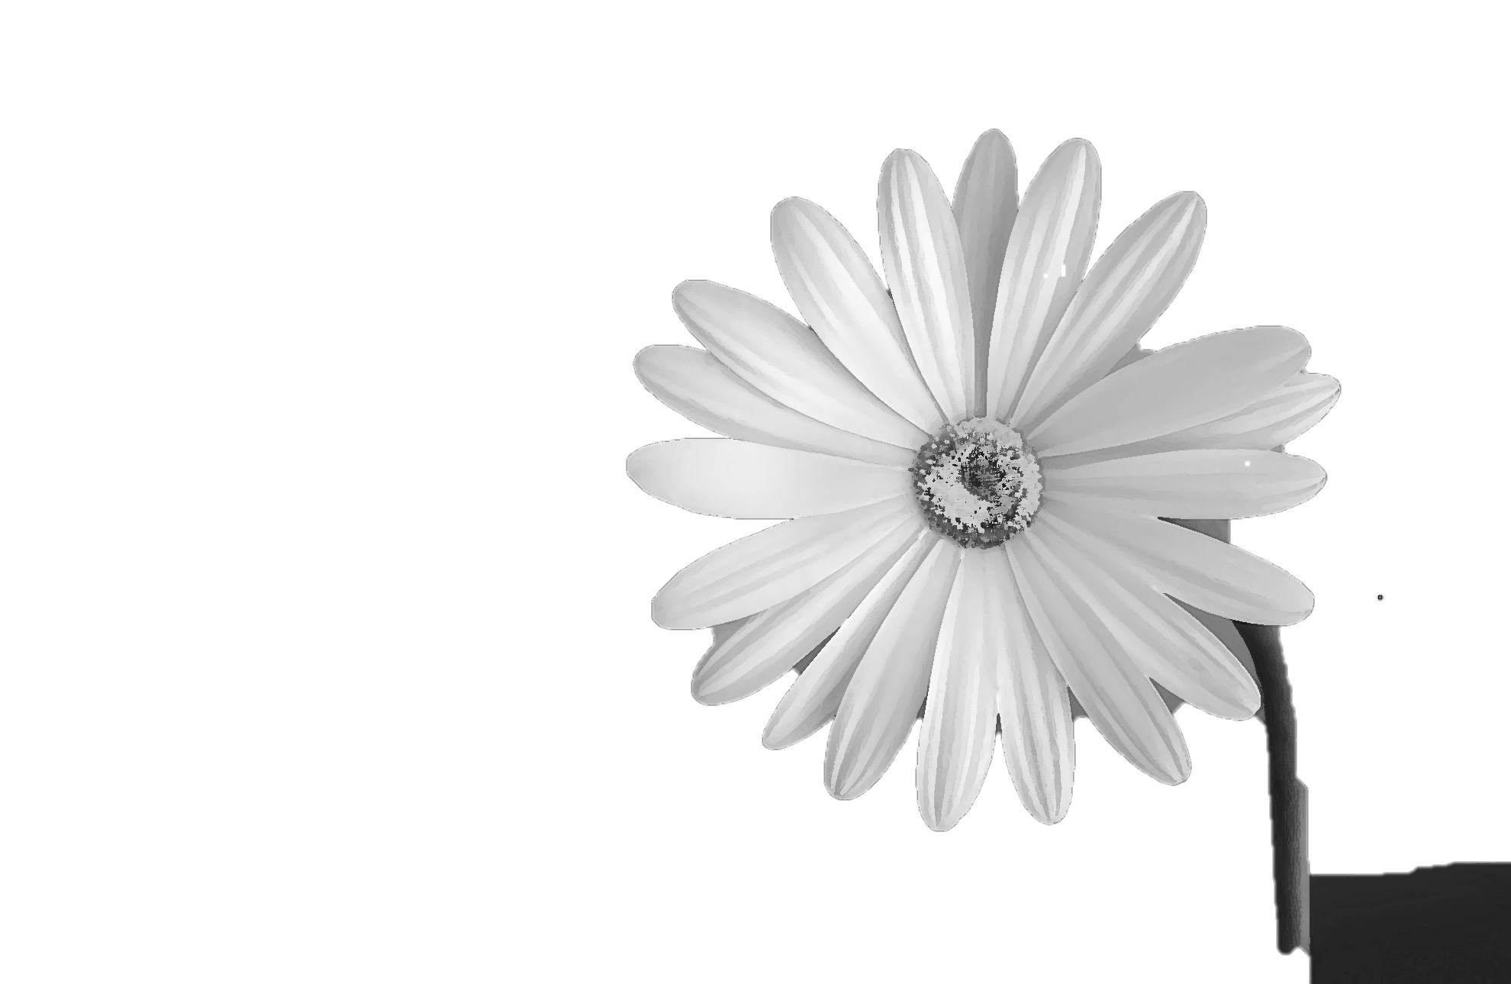
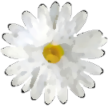

heterospecific pollen deposition
stigmas clogged by other species pollen

Slide 25

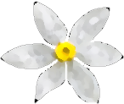
conspecific pollen transfer
pollen lost to other species

